Slide 1
Karamah: A Case Study of Judicial Education From Palestine
Reem Bahdi
Associate Professor
University of Windsor, Canada

Slide 2
Karamah: Background
A Palestinian judicial education program focused on dignity, 2005 to 2011 (2 yr break)
Birzeit University (Palestine)
University of Windsor (Canada)
financial support from the Government of Canada

Slide 3
Karamah: Results (Evaluation Report)
They developed new ways to bring a measure of dignity to the legal system given their power through the judicial office. Example:
ordering in camera testimony for witnesses in sexual assault and juvenile cases
assessment of the power imbalance between litigants
prompt resolution of cases (slow justice is injustice), especially in cases of sexual assault and sexual harassment
improved treatment of litigants and witnesses by explaining their rights and considering their special needs in the court room.

Slide 4
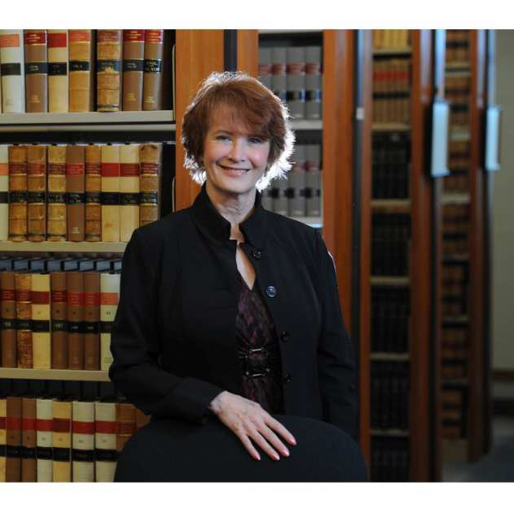
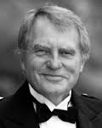
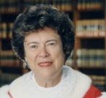
Canadian Judicial Advisors

Slide 5
Dignity as Form and Substance
How to ensure that hierarchies imposed by development projects do not run counter to the goals of the program and overtake relationships?
Predominantly Palestinian staff
Canadians largely volunteers (no consultants)
Interdisciplinary working groups (Palestinian pedagogues, gender experts, legal researchers, philosopher, judges)
Palestinian judiciary surveyed to identify priorities
Gender required cross-cutting theme

Slide 6
Methodology
Interdisciplinary working groups identify topics of general concern and interest – then ask how does social context relate?
On-site learning – eg. first judicial visit to juvenile prison in Ramallah (after participating in judicial education modeling program in Canada)
Learn social context from those who have the knowledge (in this case, juveniles who are imprisoned)

Slide 7
Professional Identity, not technical training
Mitigate effects of occupation/suffering = EMPATHY
Judicial leadership and vision set by the leadership:
“We should remember that we are the servant of the people, not their master. This is how Palestine should be, and this is how the Palestinian judiciary should be.”
“The [Karamah] program focused on looking at the human side of cases. This is very important to us as a nation because we went through tough times. It has affected the way I look at all cases and has had a lasting impact on me.”

Slide 8
Enabling Environment: Civil Society
Defining social expectations vis-à-vis the justice “sector”
Providing information about social context
Protecting/valuing judicial independence

Slide 9
Role of Civil Society
During project: civil society organizations provided information about areas of judicial practice that needed to change, suggestions for reform, created “Civil Society Vision Document For the Justice Sector”
After project ended: judges, civil society and public at large invited to conference to discuss the future of dignity in the lives of the Palestinian people

Slide 10
Role of Civil Society
Project conveners: 2 universities (Windsor and Birzeit)
Before project began: judges and civil society organizations met to discuss “what model of judicial education is right for Palestine?”

Slide 11
Karamah: Results (Evaluation Report)
Judges perceived the project as a transformative experience in terms of personal and professional growth
Social context: children? Women?
Sustainable?

